Slide 1
Introduction to FHIR
David Hay
October 5, 2015

Slide 2
This presentation
Can be downloaded here:
http://gforge.hl7.org/svn/fhir/trunk/presentations/2015-10 Tutorials/Introduction to FHIR.pptx
Use “anonymous” and email address to logon
Is licensed for use under the Creative Commons, specifically:
Creative Commons Attribution 3.0 Unported License
(Do with it as you wish, so long as you give credit)

Slide 3
Agenda
Introductions
Background to FHIR
Paradigms & Architectures
Resources
API Exchange
Profiling
Implementation
Wrap up

Slide 4

Who am I?
Name: David Hay
Company: Orion Health
Background:
Involved in FHIR almost from beginning
Ex Clinician
Co-Chair FHIR Management Group
Chair HL7 New Zealand
Blog: FHIRBlog.com

Slide 5
Who are you?
What’s your background with HL7?
v2? v3? CDA? Brand new?
What’s your role?
Developer? Manager? Clinician? Other?
What’s the single most important thing for you to get out of today’s course?
Please be brief!

Slide 6
Tutorial Objectives
You should:
Know where FHIR fits in the broader healthcare landscape, including other HL7 specifications
Be able to explain what FHIR is to others in your organization, and what impact it might have
Be equipped to help your organization determine if, when, where and how you might use FHIR
Know how to approach the FHIR specification to find out what more you need to know
Be prepared for the more detailed tutorials
Be able to engage with the community
Notes:
9:15

Slide 7
What is FHIR?
DSTU 2

Slide 8

Answer: An instigator of bad puns
FHIR is the hottest thing since . . .
This spec is spreading like wild. . .
This company is really on FHIR
Feel free to come up with your own
(but please, not here ☺)

Slide 9
The acronym
F – Fast (to design & to implement)
Relative – No technology can make integration as fast as we’d like
H – Health
That’s why we’re here
I – Interoperable
Ditto
R – Resources
Building blocks – more on these to follow
Notes:
9:25

Slide 10
Genesis of FHIR
Has been a need to share healthcare information electronically for a long time
Increasing pressure to broaden scope of sharing
Across organizations, disciplines, even borders
Mobile, Device & Cloud-based applications
Faster – integration in days or weeks, not months or years
Notes:
v2 is over 25 years old

Slide 11
Genesis of FHIR
Q: So what did HL7 have to offer in this space?
A: Not much
V2 old, and limited by it’s own rules (though hugely successful)
V3 too slow and too hard
CDA has success, but both limited and too hard
Different contexts of interoperability → different representations that aren’t compatible
Nothing suitable for light-weight integration, or for Health 2.0

Slide 12

Genesis of FHIR
HL7 undertook a “Fresh look”
What would healthcare exchange look like if we started from scratch using modern approaches?
Web search for success markers led to RESTful based APIs
Exemplar: Highrise (https://github.com/37signals/highrise-api)
Drafted a healthcare exchange API based on this approach

Slide 13
Timeline: Where does FHIR fit?
V2
1987
Start V3
1995
V3
CDA
2005
Fresh
Look
2011
FHIR
DSTU
2014
10 years
3
years
1980
1990
2000
2010
2020

Slide 14
FHIR Principles

Slide 15
Business Case for FHIR
Predefined Resources & API
Analysis already done, and can be safely extended
All paradigms, All Architectures, All Clients
Thick client, browser, mobile, devices
Implementer friendly
Simple to understand and access with examples
Familiar tooling & familiar technologies – XML/JSON, HTTP, SSL, OAuth
Libraries available – HAPI, Furore, reference implementation
Mobile friendly
Concise, REST API & JSON
Don’t need to understand HealthCare domain to implement
Developers or Analysts
Already in use Internationally
70 Organizations, 20 Countries, all Continents (except Antarctica)
Involvement from Providers, Vendors, Payers, Governments
Large community for support
Results in faster, cheaper deployments that are more re-usable
Notes:
James Agnew - HAPI

Slide 16
FHIR Manifesto
Focus on Implementers
Target support for common scenarios
Leverage cross-industry web technologies
Support human readability as base level of interoperability
Make content freely available
Support multiple paradigms & architectures
Demonstrate best practice governance
Notes:
We don’t actually have a formal manifesto, but these are the principles we adhere to.

Slide 17
Implementer Focus
Specification is written for one target audience: implementers
Rationale, modeling approaches, etc. kept elsewhere
Multiple reference implementations from day 1
Publicly available test servers
Starter APIs published with spec
C#, Java, Pascal, ObjectiveC, Javascript
Connectathons to verify specification approaches
Instances you can read and understand ☺
‘Safe’ extensibility baked in
Lots of examples (and they’re valid too)
using HL7.Fhir.Instance.Model;
using HL7.Fhir.Instance.Parsers;
using HL7.Fhir.Instance.Support;
XmlReader xr = XmlReader.Create(
new StreamRead
IFhirReader r = new XmlFhirReader
// JsonTextReader jr = new JsonTe
// new StreamRead
// IFhirReader r = new JsonFhirRe
ErrorList errors = new ErrorList(
LabReport rep = (LabReport)Resour
Assert.IsTrue(errors.Count() == 0
Notes:
Who’s read the v3 spec? – modeler & balloter focused
Spec is driven by people who write code
Numerous pieces have been changed because of experience with what worked when trying to implement
Even have a test workbench for RESTful servers
External libraries already available
Whole spec is built like software project

Slide 18
Support “Common” Scenarios
Focus on scenarios implementers ask for
Inclusion of content in core specification is based on core content rule
“We only include data elements if we are confident that most normal implementations using that resource will make use of the element” (80%)
Other content in extensions (more on this later)
Easy to say, governance challenge to achieve
Resources are simple and easy to understand and use
Notes:
Design by constraint failed – years to develop, what was produced required yet more design to be implementable and after that might not be interoperable
How to determine the 80%? Look to existing specs – v2, v3, CDA templates, OpenEHR, jurisdictional projects, what implementations we’ve seen
If not sure, err on the side of “not in for now”
Note: not 80% of instances, 80% of implementations
Challenges with “raising the bar”
What happens when there aren’t many/any implementations?

Slide 19
Web technologies
HTTP
DataTypes W3C complaint
Instances shared using XML or JSON
REST supported
Web calls work the same way they do for Google, Facebook & Twitter
Rely on HTTPS, OAuth, etc. for security functions
Atom was used for bundles
Replaced in DSTU-2
Notes:
We try very hard to *not* invent stuff that exists elsewhere unless it’s really broken or totally unaligned with the FHIR principles.

Slide 20

Human Readable
CDA has both narrative and data
The data / narrative dynamic exists throughout the process
In FHIR, every resource should have a human-readable expression
Can be direct rendering or human entered
Notes:
Even when you think your target will understand all the encoded data, reality is data often gets shared beyond the originally intended context
Allow for exceptions for things like automated device readings, etc.

Slide 21
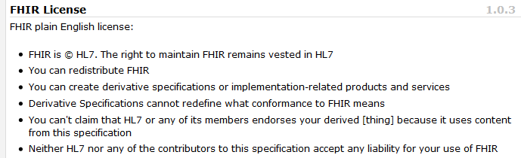
Freely available
Unencumbered – free for use, no membership required
http://hl7.org/fhir
Notes:
Was a bigger deal before HL7 decided to open up all IP
full legal text towards bottom of FHIR home page

Slide 22
Governance
Oversight
TSC
Governance
FGB
Methodology
MnM
Management
FMG
Content
Core Team
Content
Work Groups
Notes:
FHIR Governance Board
Maintains FHIR principles
Identifies risks, precepts
Handles coordination w/ external groups
FHIR Management Group
Coordinates Work Groups
Manages ballot process
Education delivery
Day-to-day activities
Modeling & Methodology
Defines criteria for artifacts
Determines processes
Documents best practices
Work Groups
Do the actual development work
Core Team
Temporary
Takes on work Work Groups can’t
Expedites
What haven’t we talked about yet?

Slide 23
Paradigms and Architectures
Notes:
9:45

Slide 24
Paradigms
FHIR supports all interoperability paradigms
REST
Documents
Messages
Services

Slide 25
REST
“Representational state transfer” – an architecture for how to connect systems
CRUD
Outcomes
Simple stable interfaces
High Performance / Scalability
Visible Process (e.g. can debug)
Portability

Slide 26
Document
Bundle
Similar to CDA
Collection of resources bound together
Root is a “Composition” resource
Just like CDA header
Sent as part of Bundle
One context
Can be signed, authenticated, etc.
Composition
Resource 1
Resource 2

Slide 27
Message
Similar to v2 and v3 messaging
Also a collection of resources as a Bundle
Allows request/response behavior with bundles for both request and response
Event-driven
E.g. Send lab order, get back result
Can be asynchronous
Bundle
MessageHeader
Resource 1
Resource 2
Notes:
10:30

Slide 28
Service Oriented Architecture (SOA)
Do whatever you like
(based on SOA principles)
Ultra complex workflows
Ultra simple workflows
Individual resources or collections (in Bundle or other formats)
Use HTTP/S or use something else
Only constraint is that you’re passing around FHIR resources in some shape or manner
Services
Notes:
Comment about SOA discovery day

Slide 29
Operations
RPC in REST
Examples in spec
Get Patient record
Expand ValueSet
Fetch Encounter data
Resources that define Input & Output

Slide 30

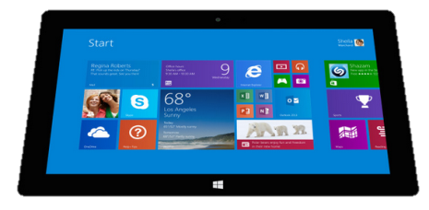
Regardless of paradigm
the content is the same
Receive a lab result in a message…
FHIR
Repository
FHIR Message
FHIR Document
Lab System
REST
National
Exchange
…Package it in a discharge summary document

Slide 31
Architectures
FHIR makes no assumptions about the architectural design of systems
You can use it for
Light or heavy clients
Central server or peer-to-peer sharing
Push or pull
Query or publish/subscribe
Loosely coupled or tightly coupled environments
With history tracking (versions) or without
Notes:
More on this later…

Slide 32
Some possible architectures
v3
v2
App
FHIR
FHIR
Broker
PHR
Interface
FHIR
DB
Notes:
You’re a message broker routing and translating between v2, v3 and FHIR
Your app interfaces with a PHR using FHIR natively
Your application can communicate using FHIR, but your software uses a proprietary RDBMS
Use FHIR as the common language for a Vendor Neutral Archive
…Or a combination….
You might see data as a nested structure of XML, a series of tables with keys, class-diagrams….

Slide 33
Repository model
HIS
LIS
PACS
PMS
FHIR
FHIR
FHIR
FHIR
Vendor Neutral Repository
Vendor Neutral Repository
FHIR
FHIR
openEHR
RLS

Slide 34
Reading the FHIR Spec

Slide 35
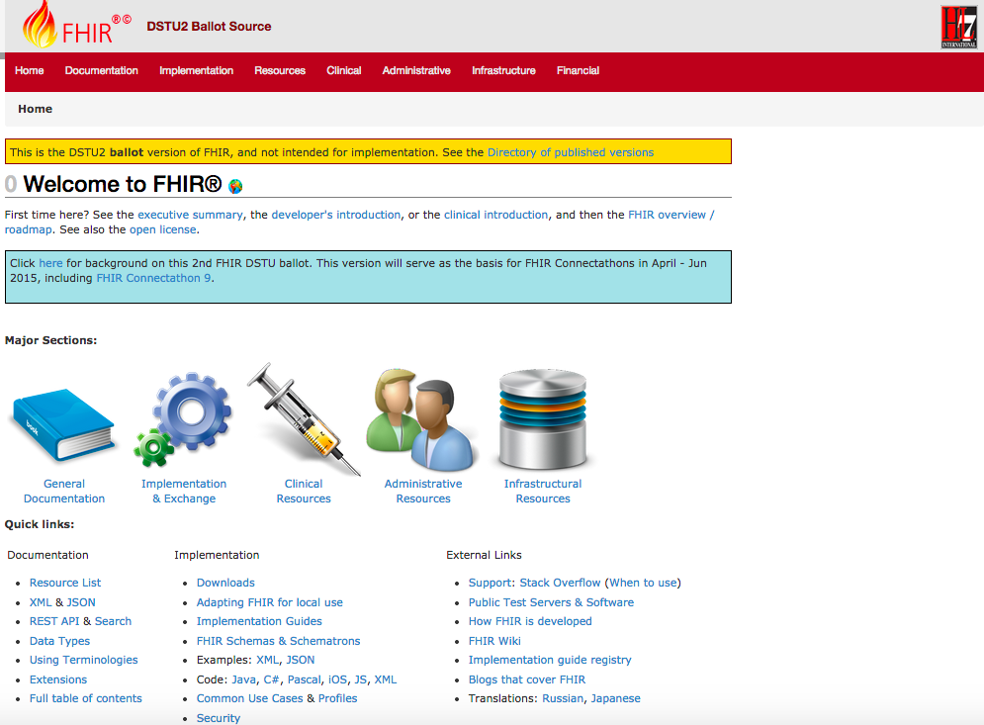
DSTU 2
DSTU-2
Notes:
Published as HTML
Published using validation process that performs consistency checks – like a software build
Really shouldn’t require much guidance to read, but a few things to call out
Objective of spec is developer can skim and decide in < day

Slide 36
2 aspects to FHIR
Content
Resources (the model)
Informed by much past work inside & outside of HL7
HL7: version 2, version 3 (RIM), CDA
Other SDO: openEHR, CIMI, ISO 13606
Others: IHE, DICOM
Profiling & the 80%
Exchange protocols - Paradigms
API
Other paradigms
Message, Document

Slide 37
FHIR Resources
Notes:
10:00

Slide 38

Resources
“Resources” are:
Small logically discrete units of exchange
Defined behaviour and meaning
Known identity / location
Smallest unit of transaction “of interest” to healthcare
V2: Sort of like Segments
V3: Sort of like CMETs

Slide 39
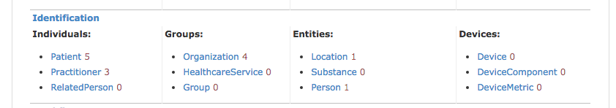
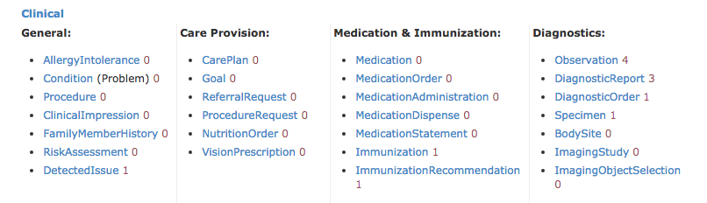
Resources - I

Slide 40
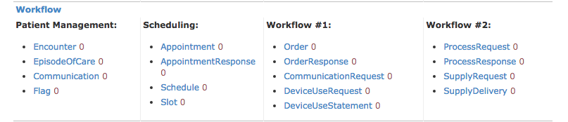
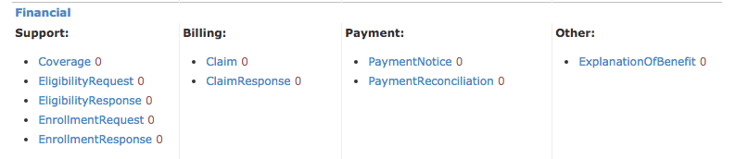
Resources - II

Slide 41
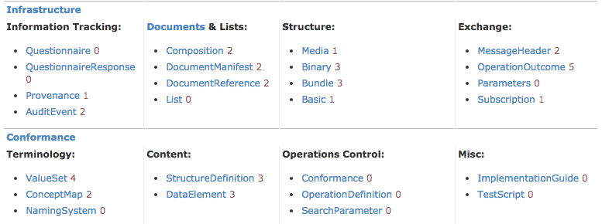
Resources - III

Slide 42
Resource anatomy
Resources have 4 main parts
Metadata
Narrative
(text)
Extensions
Defined
Structured
Data
Notes:
Defined Structured Data
The logical, common contents of the resource
Mapped to formal definitions/RIM & other formats
Extensions
“Non-common” requirements, but everyone can use
Published and managed
Narrative
Human readable (fall back)

Slide 43
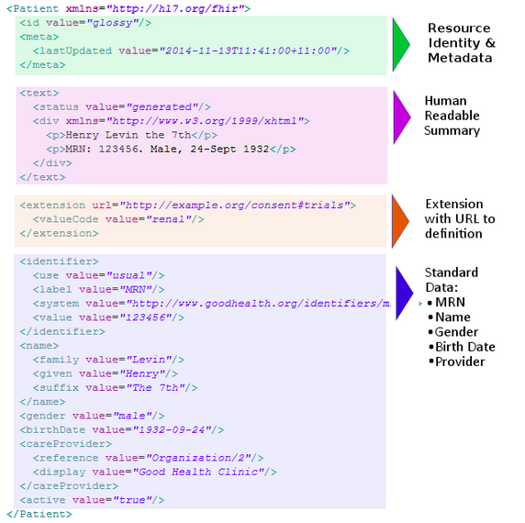

Slide 44
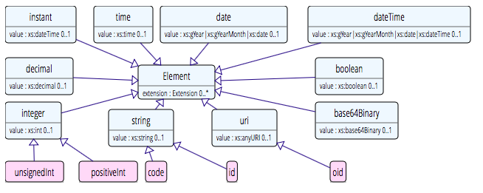
Data types:Primative
Based on w3c schema and ISO data types
Stick to the “80% rule” – only expose what most will use
Simplified

Slide 45
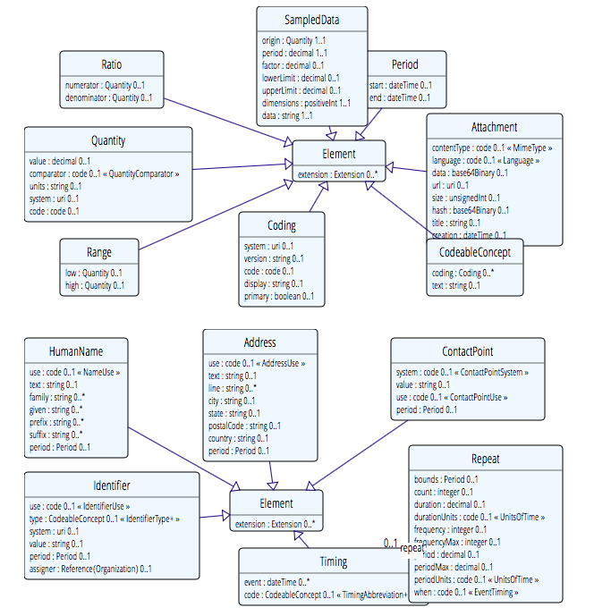
Complex

Slide 46
Example – CD datatype
ISO
Code, code system, code system name, code system version, value set id, value set version, coding rationale, updateMode, flavorId, nullFlavor, controlAct root & extension, validTime low and high
displayName with language and translations
originalText with mediaType, language, compression, integrityCheck, thumbnail, description, translations, reference (can be text, video, whatever)
Translations (most of same info as code)
Source code

Slide 47
Example – CD datatype
FHIR
Code, code system, code system name, code system version, value set id, value set version coding rationale, updateMode, flavorId, nullFlavor, controlAct root & extension, validTime low and high
displayName with language and translations
originalText with mediaType, language, compression, integrityCheck, thumbnail, description, translations, reference (can be text, video, whatever)
Translations (most of same info as code)
Source code

Slide 48
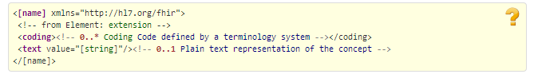
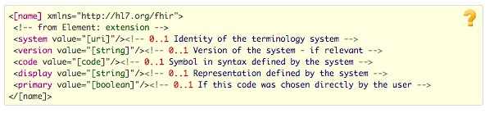
CodeableConcept
CodeableConcept
Coding

Slide 49
Visualizing FHIR
clinFHIR
Educational tool
For non-techies (especially clinicians & BA)
Beta software!
Resource Builder
View Resources
Create Condition
Notes:
For the non-techies

Slide 50
Resource Documentation
For each Resource:
Scope and Usage Notes
Resource Content (UML and XML)
Terminology Bindings
Constraints
Implementation Issues
Search Parameters
Examples, Profiles, Formal Definitions
Mappings to RIM, CDA, v2, etc

Slide 51
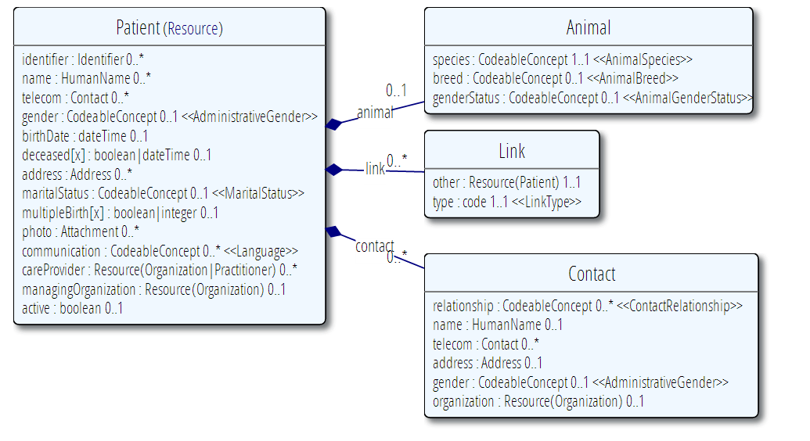
Example Resource Definitions

Slide 52
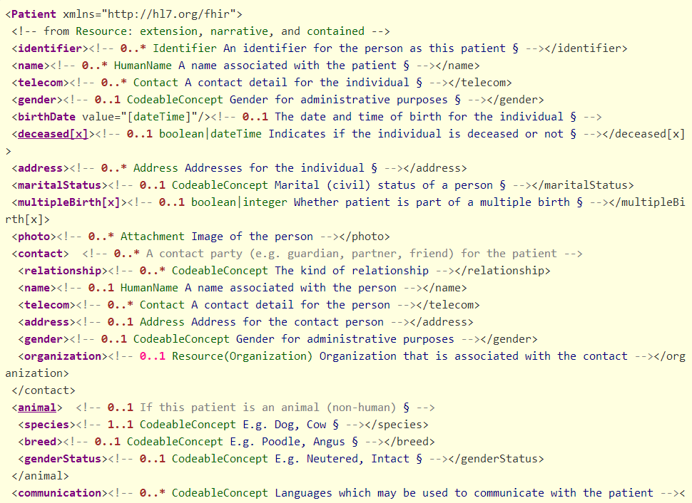

Slide 53
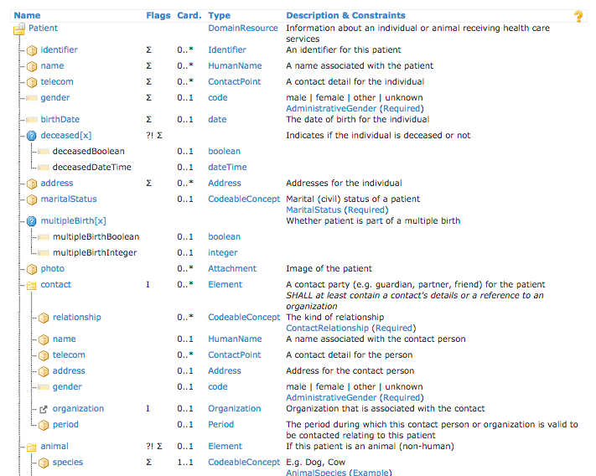

Slide 54
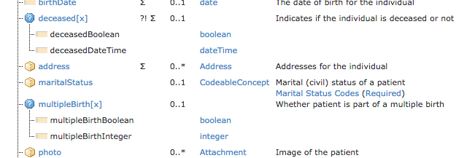
Polymorphic Properties
Where a property can have different datatypes
Can use a profile to restrict to specific type
To come!

Slide 55
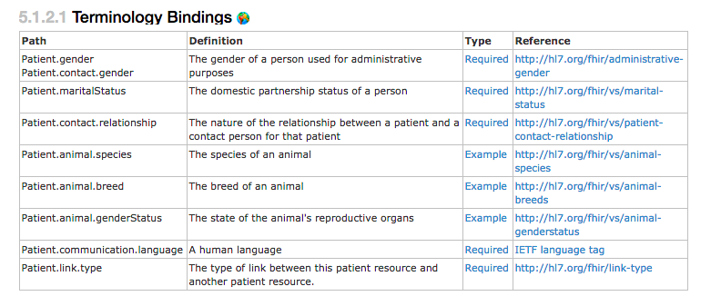
Bindings
For coded elements

Slide 56
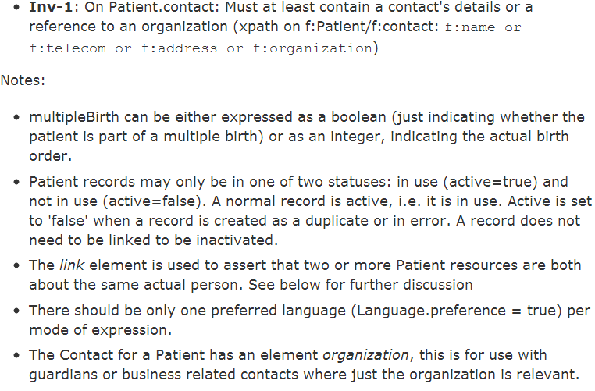
Constraints & Notes

Slide 57
In the spec
View a resource in more detail…

Slide 58
Identity
2 different ‘sorts’ of identity
ID identifies a resource on a server
Is metadata
Will change between servers
Identifier
Business identifier
Is an element in the resource

Slide 59
A Resource’s ID
http://server.org/fhir/Patient/1
resource type
endpoint
id
Note: This URL resolves to the current version of a resource
It’s also specific to a server
Notes:
This is not only the URL you use to retrieve the resource, it’s also its id.
All URL’s in FHIR are case-sensitive (and so is the id)

Slide 60
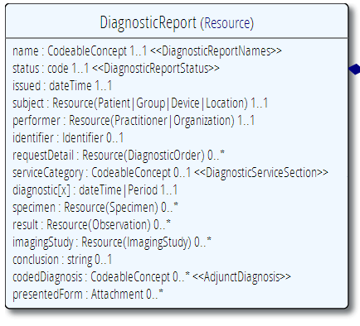
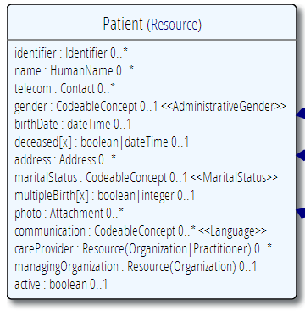
“Business” identifiers
Notes:
Resource Id’s (=URLs) are infrastructural id’s, they differ from “business” identifier.
Many Resources also have business identifiers, they are explicitly modeled, like Patient.identifier (even more than one identifier possible!)
Business identifiers are completely separate from technical resource id’s

Slide 61
It’s all about combining resources . . .
http://lab.hospitalA.org/Observation/3ff27
http://moh.govt.nz/nhi/Patient/223
Observation
Patient
Diagnostic
Report
Organization
http://lab.hospitalA.org/DiagRep/4445
Practitioner
http://moh.govt.nz/hpi/Organization/1
http://moh.govt.nz/hpi/Practitioner/87

Slide 62
References
Resources are independent – don’t need other resources to correctly interpret a resource
But resources reference each other extensively to form a web of information
Need to resolve references to fully understand the data
<Procedure xmlns="http://hl7.org/fhir">
<subject>
<reference value="Patient/23"/>
</subject>
…
<report>
<reference value=”http://myServer/DiagnosticReport/45"/>
</report>
…

Slide 63
Rules for references
References can be relative or absolute
References don’t have to be to the same server
Server does not have to enforce integrity
Clients need to cater for broken links
Targets can be ‘contained’ in the resource:
<Procedure xmlns="http://hl7.org/fhir">
<contained>
<Patient id="pat">
</Patient>
</contained>
<subject>
<reference value="#pat"/>
</subject>

Slide 64
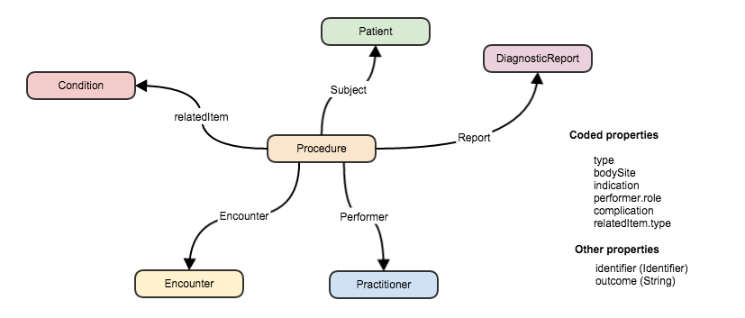
References between resources

Slide 65
Narrative
All resources can carry an html representation of their content
It’s a clinical safety issue
The receiver has a fall back option if the system is not sure it fully understands the content
It is not mandatory, but SHOULD be present
In a closed eco-system, with extremely tight control and strong conformance testing, it may not be necessary
But things often change over time
So using narrative is highly recommended
Notes:
Saves a lot of money downstream from the author

Slide 66
Narrative XHTML
Narrative is XHTML. Formatting allowed:
Tables, lists, divs, spans
Bold, Italics, styles etc
E.g. all static content
Features not allowed:
Objects, scripts, forms – no active content
Links, Stylesheets, iframes – web context
Local storage, Microdata (no active content)
Concerns are security and clinical safety

Slide 67
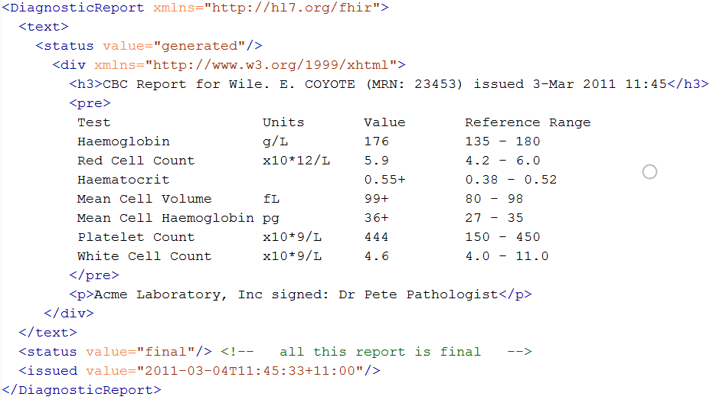
Narrative example
Notes:
Resources SHOULD always contain narrative to support human-consumption as a fallback. However, in a strictly managed trading systems where all systems share a common data model and additional text is unnecessary or even a clinical safety risk, the narrative may be omitted.
generated The contents of the narrative are entirely generated from the structured data in the resource.
extensions The contents of the narrative are entirely generated from the structured data in the resource and some of the content is generated from extensions.
additional The contents of the narrative contain additional information not found in the structured data.
empty the contents of the narrative are some equivalent of "No human-readable text provided for this resource".

Slide 68
Vocabulary
Support for coded data of varying complexity
Some codes defined as part of resource, others referenced from external vocabularies
LOINC, SNOMED, UCUM, etc.
Recognition some will differ by implementation space
Can use Value Set resource to define more complex or specific code lists

Slide 69
Terminology
a discipline that systematically studies the “labeling or designating of concepts” particular to one or more subject fields or domains of human activity
Wikipedia

Slide 70
FHIR Resource Datatypes
Resource element datatypes of different ‘categories’
References to other resources
Non-coded data
Coded data
Coded data
Code
Coding
CodeableConcept
(Quantity)

Slide 71
Examples
Code: "status" : "confirmed"
Coding: { "system": "http://www.nlm.nih.gov/research/umls/rxnorm", "code": "C3214954", "display": "cashew nut allergenic extract Injectable" }
CodeableConcept: { "coding": [{ "system": "http://snomed.info/sct", "code": "39579001", "display": "Anaphylactic reaction“ }], "text" : "Anaphylaxis" }

Slide 72
Terminology Sub-system
Code System:
Defines a set of concepts with a coherent meaning Code Display
Definition
SNOMED CT / LOINC / RxNORM
HGVS, ICPC, MIMS + 100s more
ICD-X+
ANZSCO, METEOR
A drug formulary
A config table in an application
A list of enums in a java class
Australian state codes

Slide 73
Terminology Sub-system
Code System:
Defines a set of concepts with a coherent meaning Code Display
Definition
Value Set:
A selection of a set of codes for use in a particular context
Selects
Notes:
Eg condition with different specialties

Slide 74
Terminology Sub-system
Code System:
Defines a set of concepts with a coherent meaning Code Display
Definition
Value Set:
A selection of a set of codes for use in a particular context
Element Definition: Type and Value set reference
Binds
Selects

Slide 75
Terminology Sub-system
Code System:
Defines a set of concepts with a coherent meaning Code Display
Definition
Value Set:
A selection of a set of codes for use in a particular context
Element Definition: Type and Value set reference
Binds
Selects
Conforms
Element: code/ Coding/ CodeableConcept
Refers to

Slide 76
Binding Strength
How closely the options in the value set should be followed
Values
Required (must come from set)
Extensible (may use alternate if have to)
Preferred (don’t have to, but should)
Example (set isn’t specified)
Can use extension to vary
(Make stronger not weaker)

Slide 77
ValueSet resource
Defines list of possible values for a particular context
Can reference external Terminology/s
Or define own sets
Why?
A common valueSet improves recording consistency
Improves user experience (pick lists)
Examples in New Zealand
ED diagnoses (derived from SNOMED)
NZ POCS (Pathology Observation Code Set) (derived from LOINC)
List of NZ Iwi (defined in ValueSet)

Slide 78
ValueSet for condition.code
{
"resourceType": "ValueSet",
"id": "valueset-condition-code",
"meta": {
"versionId": "1",
"lastUpdated": "2015-05-08T16:18:23Z",
},
"text": {
"status": "generated",
"div": ”Condition.code sample ValueSet"
},
"url": "http://hl7.org/fhir/vs/condition-code",
"version": "0.5.0",
"name": "Condition/Problem/Diagnosis Codes",
"publisher": "FHIR Project team",
"contact": [
{
"telecom": [
{
"system": "url",
"value": "http://hl7.org/fhir"
}
]
}
],
"description": "Example value set for Condition/Problem/Diagnosis codes",
"copyright": "This value set includes content from SNOMED CT, which is copyright © 2002+ International Health Terminology Standards Development Organisation (IHTSDO), and distributed by agreement between IHTSDO and HL7. Implementer use of SNOMED CT is not covered by this agreement",
"status": "draft",
"experimental": true,
"compose": {
"include": [
{
"system": "http://snomed.info/sct",
"filter": [
{
"property": "concept",
"op": "is-a",
"value": "404684003"
}
]
}
]
}
}

Slide 79




Terminology Server
Provides ‘services’ for consumers to access terminology
Hide the complex stuff from a consumer
Uses Operations framework
Get definition for a concept
Find a concept
Within a ValueSet
Find Terms
Get Term Definition
http://hl7.org/fhir/2015May/terminology-service.html
Notes:
Expand
http://fhir-dev.healthintersections.com.au/open/ValueSet/valueset-condition-code/$expand?filter=diabetes
Lookup
http://fhir-dev.healthintersections.com.au/open/ValueSet/$lookup?system=http://loinc.org&code=8480-6

Slide 80
Exercise: Using a Terminology Server
clinFHIR
Resource builder (Condition)
Condition.code
Explore data set
Direct REST query from filter

Slide 81
resource misc.
Notes:
10:15

Slide 82
Tags
Contain metadata about resources
Beyond ID, version & date
Used for different purposes:
Compliance to Profile
Security – e.g. sensitivity of resource
Indicate Document/Message
User defined
Transported in different ways:
REST – as an HTTP header
In a bundle (document, message, transaction) - in the metadata element of the resource or the bundle

Slide 83
Versioning
Most recent version
http://server.org/fhir/Patient/1
Returns single resource
All versions
http://server.org/fhir/Patient/1/_history
Returns bundle of versions
Specific version
http://server.org/fhir/Patient/1/_history/1
Returns single resource
Version support is optional
Notes:
Works at instance and type level – originally there

Slide 84
Version history – and revival
33, v13 – 2012-12-05
/server.org/fhir/Patient/33/_history/13
33, v14 – 2012-12-08
/server.org/fhir/Patient/33/_history/14
33, v15 – 2012-12-09
/server.org/fhir/Patient/33/_history/15
33, v16 – 2012-12-10
/server.org/fhir/Patient/33/_history/16
33, v17 – 2012-12-11
/server.org/fhir/Patient/33/_history/17
/server.org/fhir/Patient/33
Notes:
* The resource returns back to life!

Slide 85
Bundles
When more than one resource needed
Query result
Document
Message
Transaction
Specific Resource
Was “Atom feed” with JSON representation

Slide 86
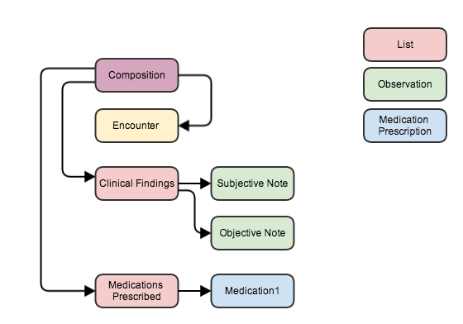
Bundle as a serialized Object Graph
Notes:
Imagine that all resources in a single bundle
Links maintain references
Comment on new recources (cid: id’s)

Slide 87
Contained Resources
When there is no external identity
Has limitations
No reuse
Very hard to ‘resolve’ to ‘real’
Use when you have to
Notes:
Reuse – example of practitioner- in encounter – name change

Slide 88
Resource exchange
via REST API

Slide 89
REST in practice
“Resources” with an explicit and stable URI
The name for what gets exchanged in REST
Defined behaviour and meaning
Known identity / location
Quite an abstract idea
Formats: XML / JSON / RDF
Exchange using HTTP
Security: SSL / OAuth
“REST” followed loosely, hence “RESTful”

Slide 90
REST Operations
CRUD:
Create – create a new instance of data
Read – get the content (state) of an instance of data
Update – change the content of an instance of data
Delete – remove the instance of data
Notes:
Delete isn’t necessarily physical
Execute – eg transaction

Slide 91
FHIR RESTful Interactions
Instance
Read GET [base]/Patient/100
Vread GET [base]/Patient/100/{vid}
Update PUT [base]/Patient/100
Delete DELETE [base]/Patient/100
History GET [base]/Patient/100/_history
Type
Create POST [base]/Patient
Search GET [base]/Patient?name=eve
History GET [base]/Patient/_history
Validate POST [base]/Patient/100/_validate/{id}
System
Conformance GET [base]/metadata
Transaction POST bundle to root
History GET [base]/_history
Search GET [base]/Patient?name=eve
Notes:
If >1 then in a bundle
Can use _format parameter or headers for XML/JSON

Slide 92
RPC (Operations) vs REST
RPC (Remote Procedure Call):
Ask a server to perform some operation
Hand it a set of parameters
Server performs some operations
Returns a set of parameters
REST:
Define a URI that represents the state of something
Tell the server what the state should be
Server makes the state change happen

Slide 93
RPC vs REST example
Example:
A device that monitors a patient %0₂ Sat
Raises an alarm on EHR if it’s too low
EHR can turn the alarm off
RPC:
POST http://acme.org/devices/turnOffAlarm
Parameters: device id, alarm id
REST:
POST http://acme.org/devices/[deviceid]/[alarmid]
Content: data to say “Alarm is off”

Slide 94
Playing with FHIR
Access public server
Notes:
Sample CRUD stuff
Search for patient on name
Specify json or xml
Get a patient
Update a patient
Grahames & Ewouts server

Slide 95
Profiles & conformance
Notes:
10:15

Slide 96
The need for Profiles
Many different contexts in healthcare, but a single set of Resources
Need to be able to describe restrictions based on use and context
Allow for these usage statements to:
Authored in a structured manner
Published in a repository
Used as the basis for validation, code, report and UI generation.
Note Profiling is going to be very important
‘Message from the chair’

Slide 97
The need for Profiles
Profiles can serve the same purpose as:
CDA templates & implementation guides
HL7 v2 “static” profiles
CIMI implementation guides
OpenEHR Archetypes & templates
Profiles aren’t mandatory for interoperability, but they improve the degree of it.
Profiles never change meaning of an instance

Slide 98
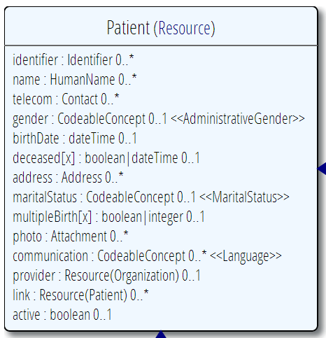
Profiling a resource. For example...
Require that the identifier uses the NHI – and is required
Limit names to just 1 (instead of 0..*)
Limit maritalStatus to another set of codes that extends the one from HL7 international
Add an extension to support “Iwi”
Note: hardly any mandatory elements in the core spec!

Slide 99
FHIR Extensions
Notes:
10:15

Slide 100
The Case for Extensions
Extensions are often problematic in existing HL7 specs
Z-segments in v2
What does this mean?
ZSB|20080117|Q^57|4.30^uL
Foreign namespaces in CDA/V3
Break schemas
Simple choice – design for absolutely everything or allow extensions

Slide 101
Extensions
FHIR has a standard framework for extensions
Built into wire format
Every FHIR element can be extended
Including datatypes
Every extension has:
Reference to a computable definition
Value – from a set of known types
Every system can read, write, store and exchange all legal extensions
All extensions are valid by schema etc.

Slide 102
Extensions
In FHIR, extensions are “normal”
Consequence of the 80% rule – keep the simple stuff simple
Extensions can exist anywhere
Resource, Element, DataType
Conformant systems can’t reject instances just because they contain unrecognized extensions
They could:
Display them
Should be in resource narrative
Store as a ‘Blob’
Make a conscious decision to ignore (unless ModifierExtension)
(Could lookup profile)
Notes:
[31/08/14 3:34:55 pm] Lloyd McKenzie: no. They can't refuse the instance because it contains extensions (unless they're modifierExtensions), but they're free to strip/ignore them.
[31/08/14 3:35:19 pm] Lloyd McKenzie: Requiring persistance would cause havoc with legacy systems

Slide 103
Extension Definition
Core part of profiling
(to come later)
A separate resource (was part of profile)
StructureDefinition
Also used for resource definition
Registries
Search before build
Promote reuse

Slide 104
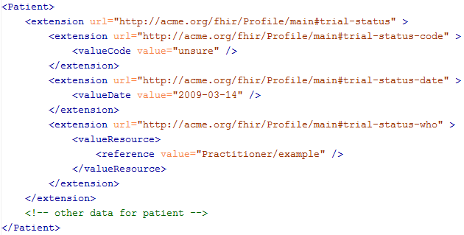
An Extension in a resource

Slide 105
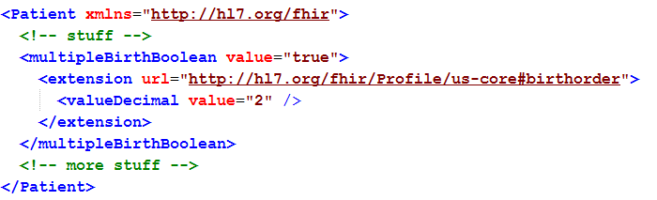
Extending a multiple birth
Key = location of formal definition
Value = value according to definition
Notes:
Really any FHIR element (Resource, Datatype, Primitive) can be extended. Just nest an <extension> element under the thing you want to extend
You should be able to go to the formal definition endpoint and get the definition of the extension.
Note: birth order is already provided for in FHIR through the multipleBirthInteger

Slide 106
Modifier Extensions
Also a core part of FHIR
Needed because some extensions can’t be safely ignored
Can’t compute on an element containing an unrecognized modifier extension. However, can:
Reject instance
Just display narrative
Retrieve definition & seek human review

Slide 107
Governing Extensions
Extensions are not a silver bullet
FHIR has a sliding scale governance for extensions
HL7 published extensions
National Standards (e.g. Standard Finnish Extensions)
Domain standards (e.g. Best Practice Cardiology)
Local Projects

Slide 108
Using Profiles
You can just go ahead and use a resource
No need for a profile
But you should write a profile
Document your usage in detail for partners
You can mark a resource or bundle with a profile
It’s just a claim – can test conformance with that
Notes:
Denormalization for performance
Comment that profiles will be really important

Slide 109
Tooling
Forge
Official profile creator
http://fhir.furore.com/forge
Go to the tutorial!
clinFHIR
An educational tool
Others will come…

Slide 110
Conformance
There’s a resource for documenting conformance to FHIR
Can be used for:
Stating how a specific system instance behaves
Defining how a software system is capable of behaving (including configuration options)
Identifying a desired set of behavior (e.g. RFP)
To declare themselves “FHIR Conformant”, a system must publish a Conformance instance
Notes:
Doesn’t have to support XML – is can be json only

Slide 111
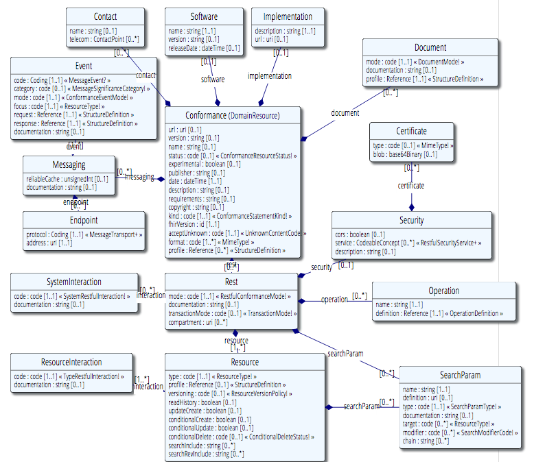
Conformance (cont’d)

Slide 112
Implementing FHIR

Slide 113
Client responsibilities
Extensions
Especially modifier
Broken references
Contained resources
Profiles don’t change wire format

Slide 114
Where can FHIR be used?
Classic in-institution interoperability
Back-end e-business systems (e.g. financial)
Regional Health Information Organizations (RHIO)
National EHR systems
Social Web (Health)
Mobile Applications
Near
Term

Slide 115
Architecture
Standalone FHIR Server
A FHIR Server in front of an existing application (e.g. SQL)
FHIR as front end to an XDS server (“MHD”)
An interface engine that ‘speaks’ FHIR
A tablet/mobile phone application
Web portal uses FHIR to access other systems
A healthcare application that access information from multiple systems as well as it’s own server
Smart-On-FHIR – an EHR plug-in framework

Slide 116
Implementation Assistance
Reference Implementations – object models, parsers, serializers, clients, validators, utilities
Schema, Schematron, Validation Pack
1000’s of examples
Live Servers to test against
http://wiki.hl7.org/index.php?title=Publicly_Available_FHIR_Servers_for_testing
Connectathons

Slide 117
Test Servers
Use the servers to explore how it works
Write clients that use the test data
Test that you got your own system right
Most developers:
Use the servers to learn
Consult the documentation occasionally
We do recommend to read the specification
(RTFS)

Slide 118
Connectathons
Open invitation to any interested party to come and write software that exchanges FHIR resources
Always hold one before HL7 meetings (last week) + Others by invitation
Mix of skills
Newbies (“where is the spec?”)
Old hands who’ve been to every connectathon
Experiment with new features
We have a virtual connectathon all the time…

Slide 119
Implementation Assistance
Skype – implementers channel – 300 participants
Stack Overflow – ask implementation questions
Link from front page
Search for answers first
Don’t ask for changes to the spec (get deleted!)
gForge Tracker – ask for changes to the spec
Link from bottom of every page
But have discussion somewhere first
Disqus – on every page of the specification
FHIR Email list, Connectathons, Tutorials

Slide 120
Migration
No expectation that people will migrate existing interfaces any time soon.
Initial adopters will be green-field, new technology
FHIR may see use behind the scenes in v2 systems before it sees use over the wire
Forthcoming policy initiatives may necessitate revisiting existing interfaces

Slide 121
Migration – v2
Already have at least one integration engine that supports translation between v2 and FHIR
Resources map to segments reasonably well
As always, the challenge with v2 mapping is the variability of v2 interfaces
“Common” mappings can be created, but they won’t be one size fits all
Increasing focus

Slide 122
Migration – CDA
Made more complex by human-readable nature
Need to ensure text <-> entry linkages are retained
Will best be handled on a template by template basis
Start with well defined ones like C-CDA
Focus of DSTU-2
Argonaut
Notes:
12:15
Text linkages not as important when not human-attested

Slide 123
What’s next?

Slide 124
Development plans
Currently DSTU-2
Additional resources will continue to be introduced in future DSTU cycles as implementers identify needs
Continue to seek testing & real world implementation experience
Normative is around 2.5 years out
We want *lots* of implementation experience before committing to backward compatibility

Slide 125

Next Steps for you
Attend the other FHIR tutorials
Architects, Developers, Profiles
Read the spec: http://hl7.org/fhir
Comment on the spec (link on each page)
Follow #FHIR on Twitter
Developer devdays
http://fhir.furore.com/Events/DevDays2015
Shape the specification:
Join the FHIR track at this WGM
Join the FHIR email list http://wiki.hl7.org/index.php?title=FHIR_email_list_subscription_instructions
Try implementing it
Make Ballot comments
Come to a Connectathon!

Slide 126
Review

Slide 127
What does FHIR provide?
Resources (building blocks)
Profiling / Extensions
Methodology
Versioning, Bundles, Profiles, Conformance
Simple Syntax (XML, JSON)
Human readability
Support for multiple Paradigms
REST, Messaging, Documents, Services

Slide 128
Business Case for FHIR
Predefined Resources & API
Analysis already done, and can be safely extended
All paradigms, All Architectures, All Clients
Thick client, browser, mobile, devices
Implementer friendly
Simple to understand and access with examples
Familiar tooling & familiar technologies – XML/JSON, HTTP, SSL, OAuth
Libraries available – HAPI, Furore, reference implementation
Mobile friendly
Concise, REST API & JSON
Don’t need to understand HealthCare domain to implement
Developers or Analysts
Already in use Internationally
70 Organizations, 20 Countries, all Continents (except Antarctica)
Involvement from Providers, Vendors, Payers, Governments
Large community for support
Results in faster, cheaper deployments that are more re-usable
Notes:
James Agnew - HAPI

Slide 129
FHIR Manifesto
Focus on Implementers
Target support for common scenarios
Leverage cross-industry web technologies
Require human readability as base level of interoperability
Make content freely available
Support multiple paradigms & architectures
Demonstrate best practice governance

Slide 130
FHIR & Cost of Integration
These factors will drive down the cost of integration and interoperability
Easier to Develop
Easier to Troubleshoot
Easier to Leverage in production
More people to do the work (less expensive consultants)
Competing approaches will have to match the cost, or disappear – effect is already being felt

Slide 131
Future impact of FHIR
Impact of FHIR on the market
Drive interoperability prices down
Higher Expectations
Sense of a community
Enormous interest from vendors and Legislators
Overall Market focus
Web based PHR
Mobile
Device Data management
Healthcare repositories (MHD+)
Retooling existing connections (v2, CDA)
Resistance is futile!
Notes:
How much integration do you need? Nx2 – twice what you have

Slide 132

Questions?
http://www.hl7.org/implement/standards/fhir/
http://hl7.org/fhir/index.html
http://wiki.hl7.org/index.php?title=FHIR

